Slide 1
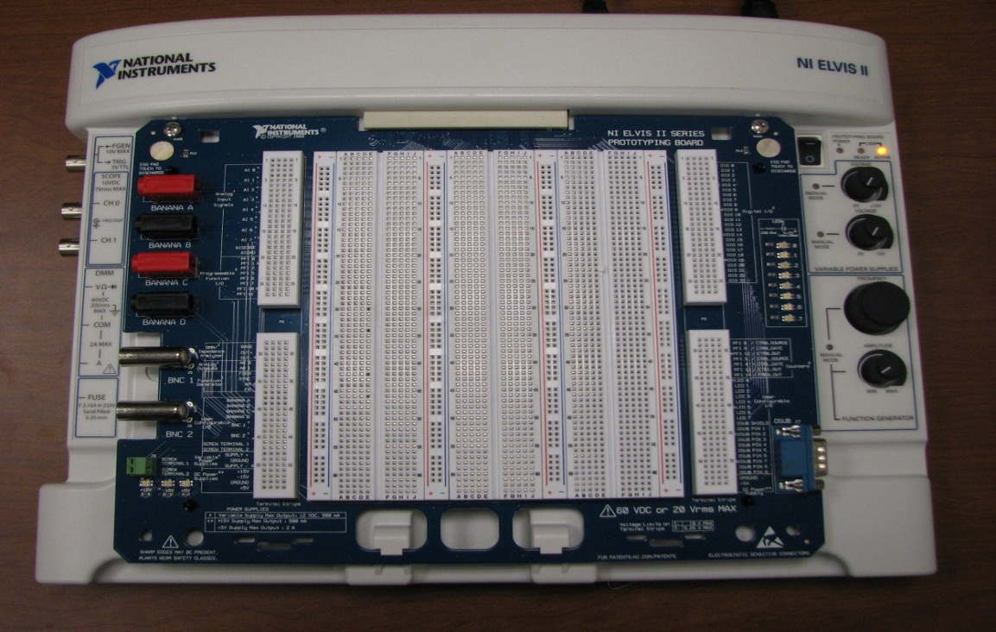
PHYS 208 ELVIS II GUIDE
ELVIS ΙΙ is the acronym for Educational Laboratory Virtual Instrumentation Suite, developed by National Instruments. It is a platform that integrates 12 typical electronics for use to use.
Four banana plugs (A, B, C, D)
Main power switch (supplies board functions- DMM, FGEN, etc.)
Function Generator
Prototyping board
Prototyping board power switch (supplies voltage)
Oscilloscope Channels
Digital multimeter (DMM) VΩ terminal
ELVIS II
DMM Common terminal
DMM A terminal

Slide 2
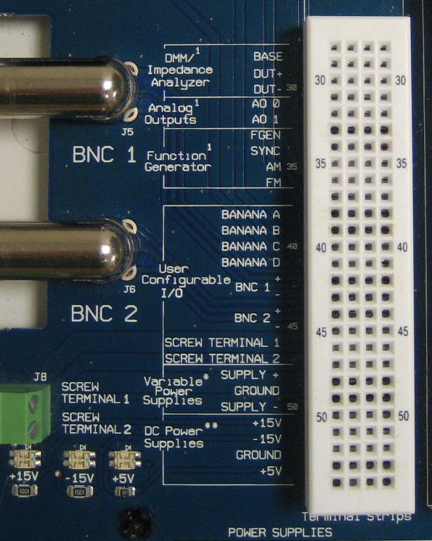
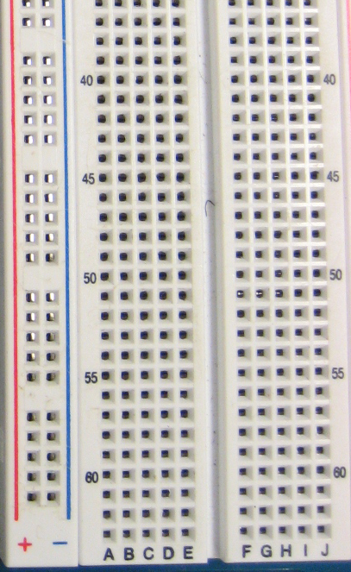
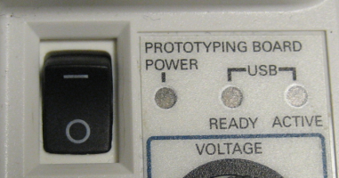
Some specifics about the prototyping board
The columns and rows are numbered or lettered for easy identification of plug holes.
The four - five clips in a row are all electrically connected.
FGEN connection.
SYNC is not used in this course
Connections to banana plugs. Each of the 4 rows is connected to one of the banana plugs
Connections to BNC terminals. Signals should connect to (+) positive strips.
If needed, either row labeled GROUND can be used, they are both connected to the common ground.
The (+) and (-) columns are electrically connected, but not to each other. They only carry a voltage if you connect them to a voltage source.
ABCDE is not connected to FGHIJ.
Connections to dc power supplies. If the Prototyping board power switch is turned on, the three voltage supply LEDs should glow green.

Slide 3
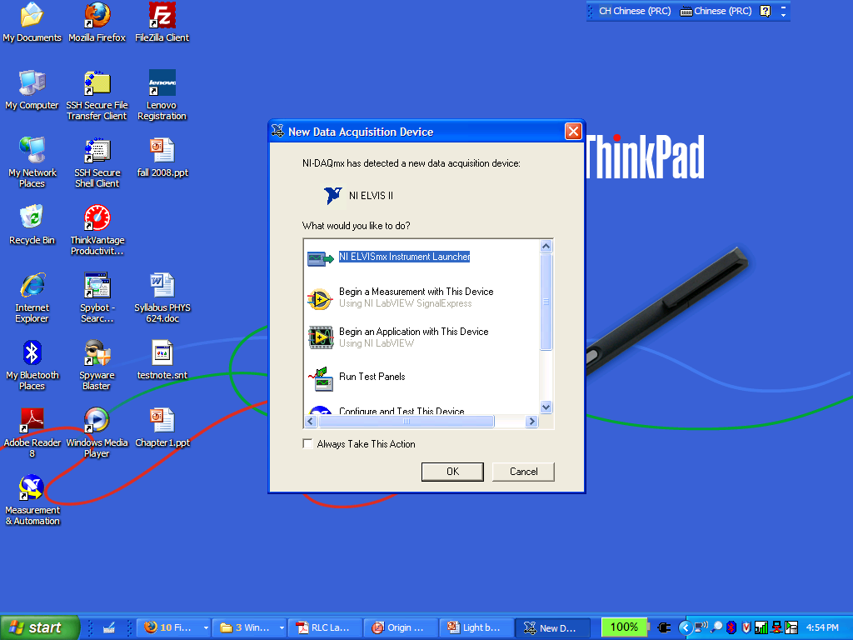
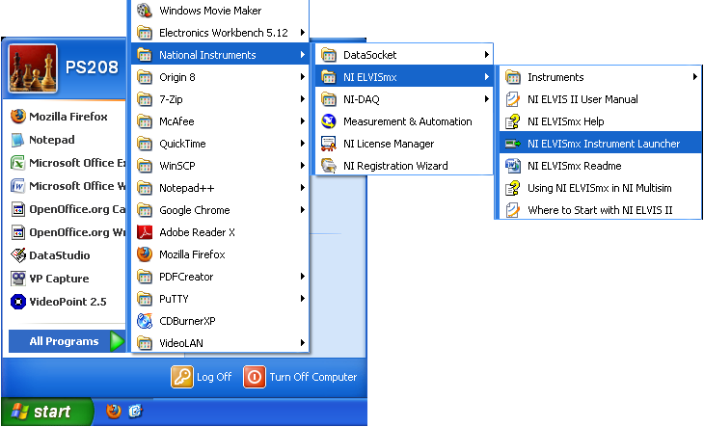
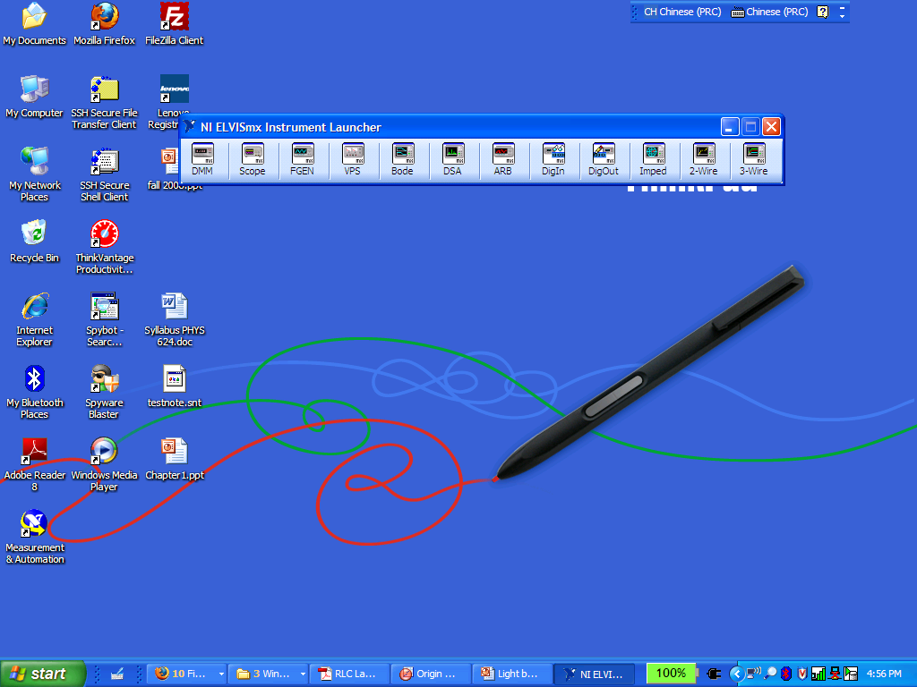
Getting the software up and running:
When the main power is turned on, a window will pop up, as shown on the right. Click on “NI ELVISmx Instrument Launcher”. Then the Instrument Launcher will appear, as shown in the lower right picture.
If The window to the right does not show up, check the connection, the power switch and then follow the path outlined below:
Start Menu
All Programs
National Instruments
NI ELVISmx
NI ELVISmx Instrument Launcher
And the instrument launcher, seen above, should open for you to use.

Slide 4
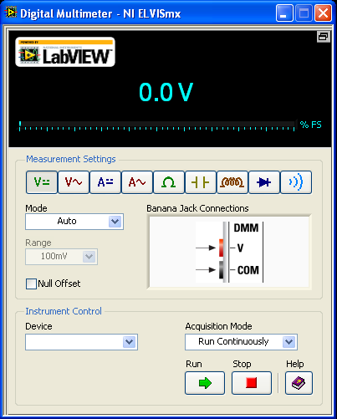
Digital Multimeter
Voltmeter:
Click on the DMM icon on the NI ELVISmx Instrument Launcher. The digital multimeter window pops up. It initially is set to be used as a DC voltmeter (note the dash/solid lines next to the V). If you need to measure AC voltage, click the button with a wavy line next to the V.
Ammeter:
For a DC ammeter click on the A with the dash/solid lines next to it. If you need to measure AC current, click on the button with a wavy line next to the A.
Ohmmeter:
Click on the Ω (Ohm) button on the DMM window. This means “resistance” measurements.
Once the right function is selected and the proper connections are made (note the small window that shows the connections necessary) to what you intend to measure, press the Run button to measure. When you are finished measuring, press the Stop button.

Slide 5
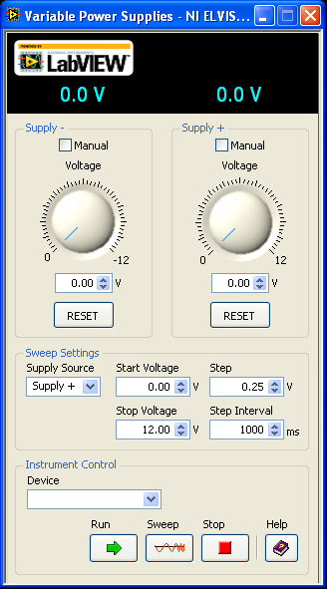
Variable Power Supply
Click on the VPS icon on the NI ELVISmx Instrument Launcher. The Variable Power Supply window pops up. See the screen shot on the right.
We have the ability to use a (+) positive or (-) negative voltage source. Generally we will be using the (+) positive source.
You may prefer to set the voltage you will be using by typing the value into these boxes.
If multiple, incremental values are necessary, the VPS has a sweep function that can be programmed for specific increments and time steps.
Once the right supply is selected/set up and the proper connections are made to what you intend to power, press the Run button to use the supply, or the Sweep button to use the sweeping function. When you are finished, press the Stop button, or if using the sweep function, the VPS will turn off automatically.

Slide 6
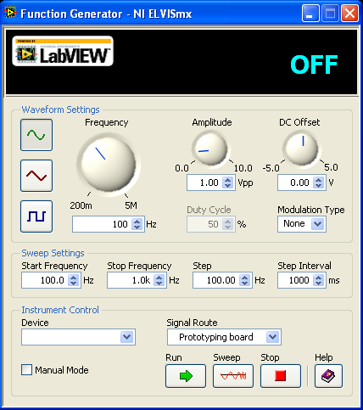
Function Generator
Click on the FGEN icon on the NI ELVISmx Instrument Launcher. The Function Generator window pops up. See the screen shot on the left.
Function type. Sinusoid, Square or Triangular wave forms.
Amplitude. In general we will be using 2-3 Vpp (peak-to-peak voltage).
Frequency. There is a dial, but for most applications, typing the frequency into the value box will produce better results.
There are two ways to connect the FGEN to your circuit. This option must correspond to how you’ve connected it, or the FGEN will not work properly.
Once the right type of function is selected, the correct frequency and amplitudes entered, and the proper connections are made, press the Run button to measure. When you are finished measuring, press the Stop button.
We may not be using the sweep function for the frequency in this class. We will not be using the DC Offset in this class.

Slide 7
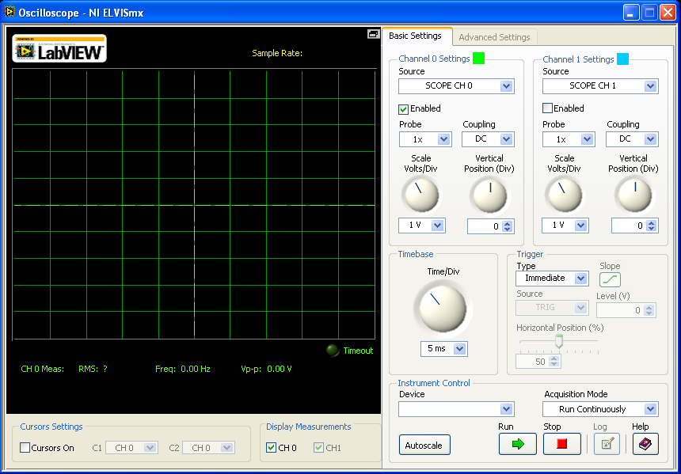
Oscilloscope: Part 1
Click on the Scope icon on the NI ELVISmx Instrument Launcher. The Oscilloscope window pops up.
To view an input signal from the board, or FGEN, along with the proper connections, the Enabled checkbox must be checked.
If two similar signals seem to be overlapped, the Vertical position will allow you to vertically separate them without changing scales.
Signals may be large or small, these knobs allow you to change the vertical voltage scale and the horizontal time scales for the best viewing of the signal on the scope.
Once the circuit is connected press the Run button to view your signal. Then adjust the settings. When you are finished viewing, press the Stop button.

Slide 8
Oscilloscope: Part 2
The Cursors are a very valuable tool with the scope. They allow you to measure the time and/or the voltage different between two points on your signal.
With the checkbox active, two vertical dashed yellow lines labeled C1 and C2 appear. The small crosshairs show the position the cursors are measuring.
The voltages and the time difference dT are displayed in yellow below the output screen.
Each channel of the scope with either display in green or blue.
The scope will automatically measure the peak-to-peak voltage correctly IF and ONLY IF the full vertical signal is shown.
The scope will also automatically measure the frequency of the signal correctly IF and ONLY IF a full waveform of the signal is shown.
These values will be displayed for the two channels in either green or blue below the output screen of the scope.

Slide 9
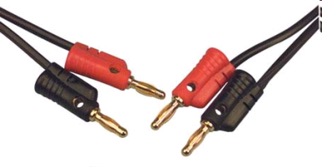
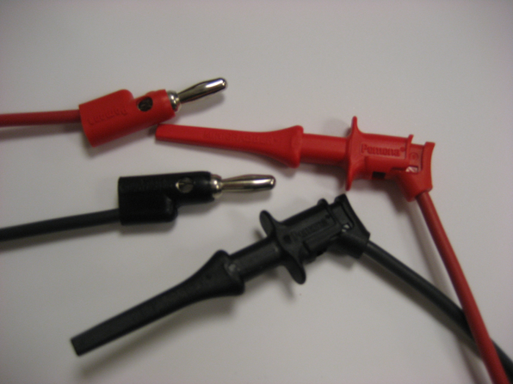
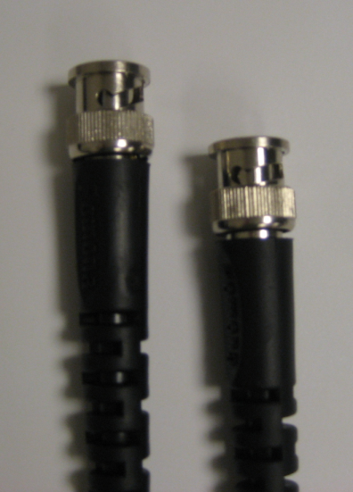
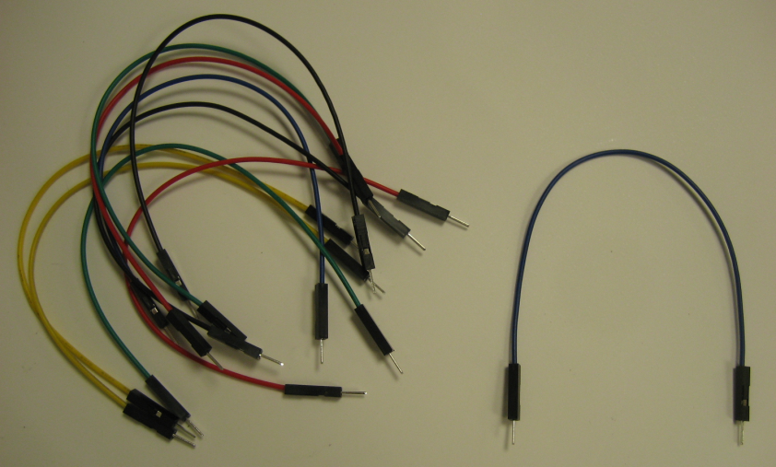
Connection Accessories
Cables with “banana” connectors are widely used. Use these cables to establish connections between DMM terminals and the banana jacks on the prototyping board.
Another type of cable you will use throughout the course is a banana-to-minigrabber cable. One end of the cable is a banana plug, and the other end is a minigrabber that can grab the pins of an electronic component.
The last type of major connection you might use is the BNC cable. This will be especially useful to connect a circuit to the oscilloscope on the computer.
You are given a box or small bag of jump wires. You will use them to connect components on the prototyping board to complete a circuit. These wires have small plugs on their ends to make it easier for you to plug them into the prototyping board correctly.

Slide 10
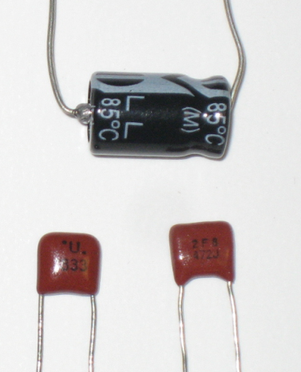
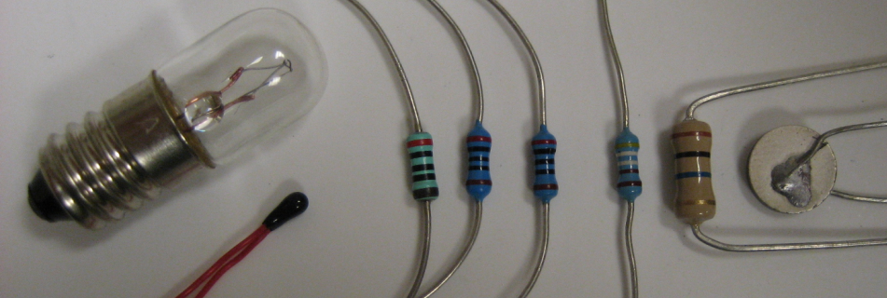
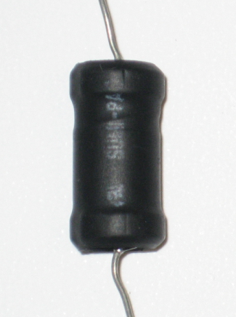
Circuit Components
Resistors. Some color-coded, others temperature or light dependent. They may come in many sizes but they all perform in the same way.
Capacitors. You might see them in either a flat or cylindrical shape.
While they look different, these two resistors are actually the same. Look at the color codes and measure the resistors before you use them! A color-code is provided in the Resistance lab.
They look the same, but these two capacitors are actually different. Measure the capacitors before you use them!
Inductors. These might look like capacitors, but they certainly don’t act like them.

